Slide 1
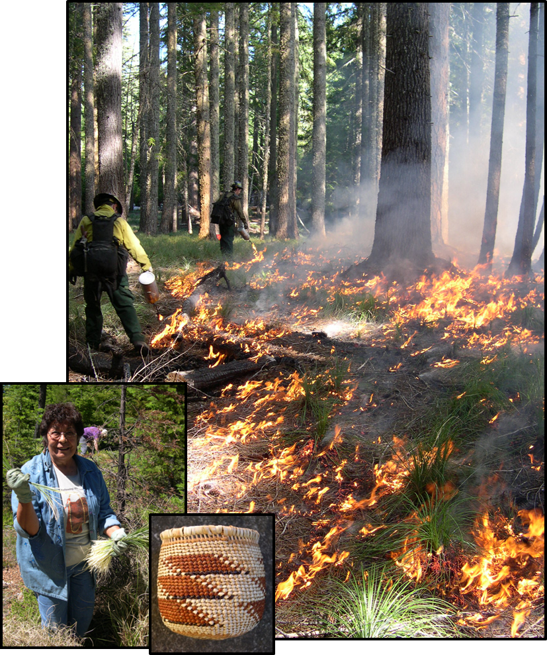
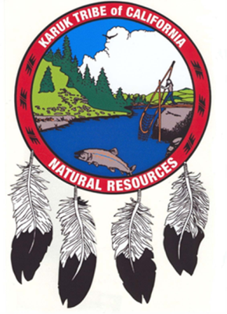
Restoring Fire to the Landscape in Indian Country
Bill Tripp
Deputy Director of Eco-Cultural Revitalization
Karuk Tribe Department of Natural Resources
Intertribal Timber Council Annual Symposium
June 26, 2014
Worley Idaho
Cultural Burns such as for bear grass enhancement can help to compartmentalize fire across broader landscapes
Notes:
Cultural Burns such as for Beargrass enhancement can help to compartmentalize fire across broader landscapes. Strategic rotational burning in resource associated patch dynamics along traversable ridge systems can reduce wildland fire intensity and severity, slow fire spread, create areas to guide fire through, and in some cases provide good black for fire to extinguish itself.

Slide 2
Peoples, Territories, Lands, and Resources
Karuk Jurisdiction defined at Territorial Scale
Humans in the past century have become factors of ecological diminishment rather than agents of renewal
Karuk Identity tied to entire landscape and its functional processes
There is a great need to re-establish humans as the keepers of balanced process and function at the territorial scale
Notes:
The Karuk, like most indigenous populations are a people of place. We are not intended to be confined within the right angles of todays map. The interesting thing about indigenous knowledge, practice, and belief, is that it is inclusive by intent. Inclusive of all living things, yet bound exclusively to within its own range of beneficial influence. Due to severe lack of trust, history of knowledge exploitation, and societal segregation, Tribal knowledge in general is now confined to within square blocks of real estate; confined to individuals and families who are watching the diminishment of our natural world. We are still watching humans fight the very process should be giving life, and thereby exacerbating its destructive force.
Fire is central to many indigenous cultures. In the Karuk way of life, it is both spiritual and utilitarian. It is said that the smoke carries the prayers, but the fire answers them. Tribal and non-tribal communities agencies and institutions are working toward a common vision and foundation of indigenous knowledge practice and belief in order to eliminate the perception of risk through achievement of integrated benefits within the scope of natural law.

Slide 3
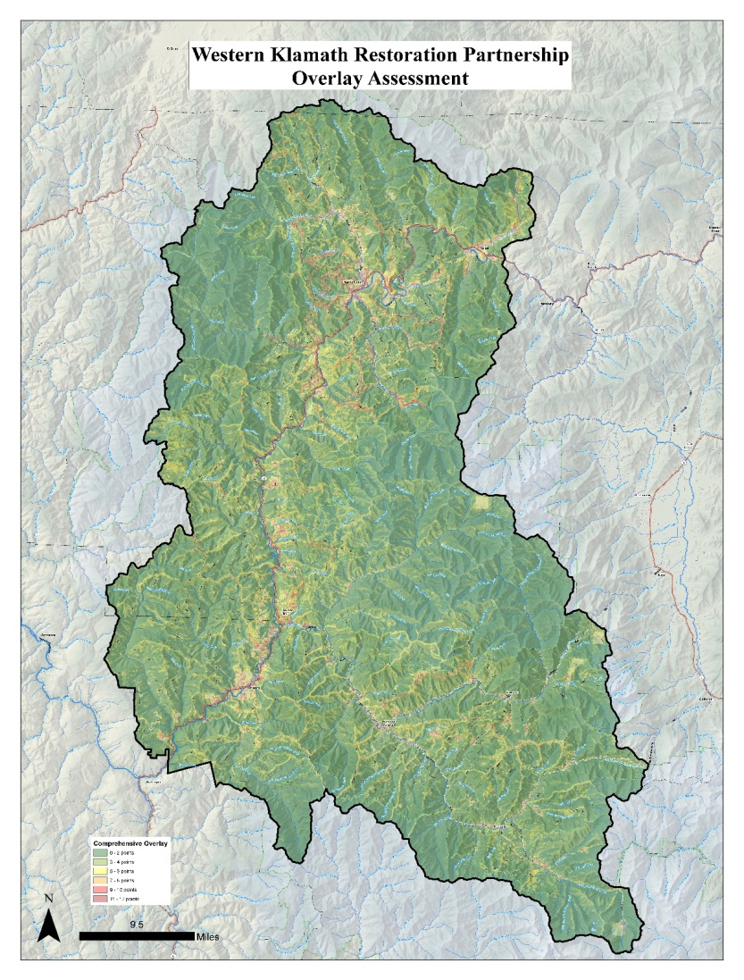
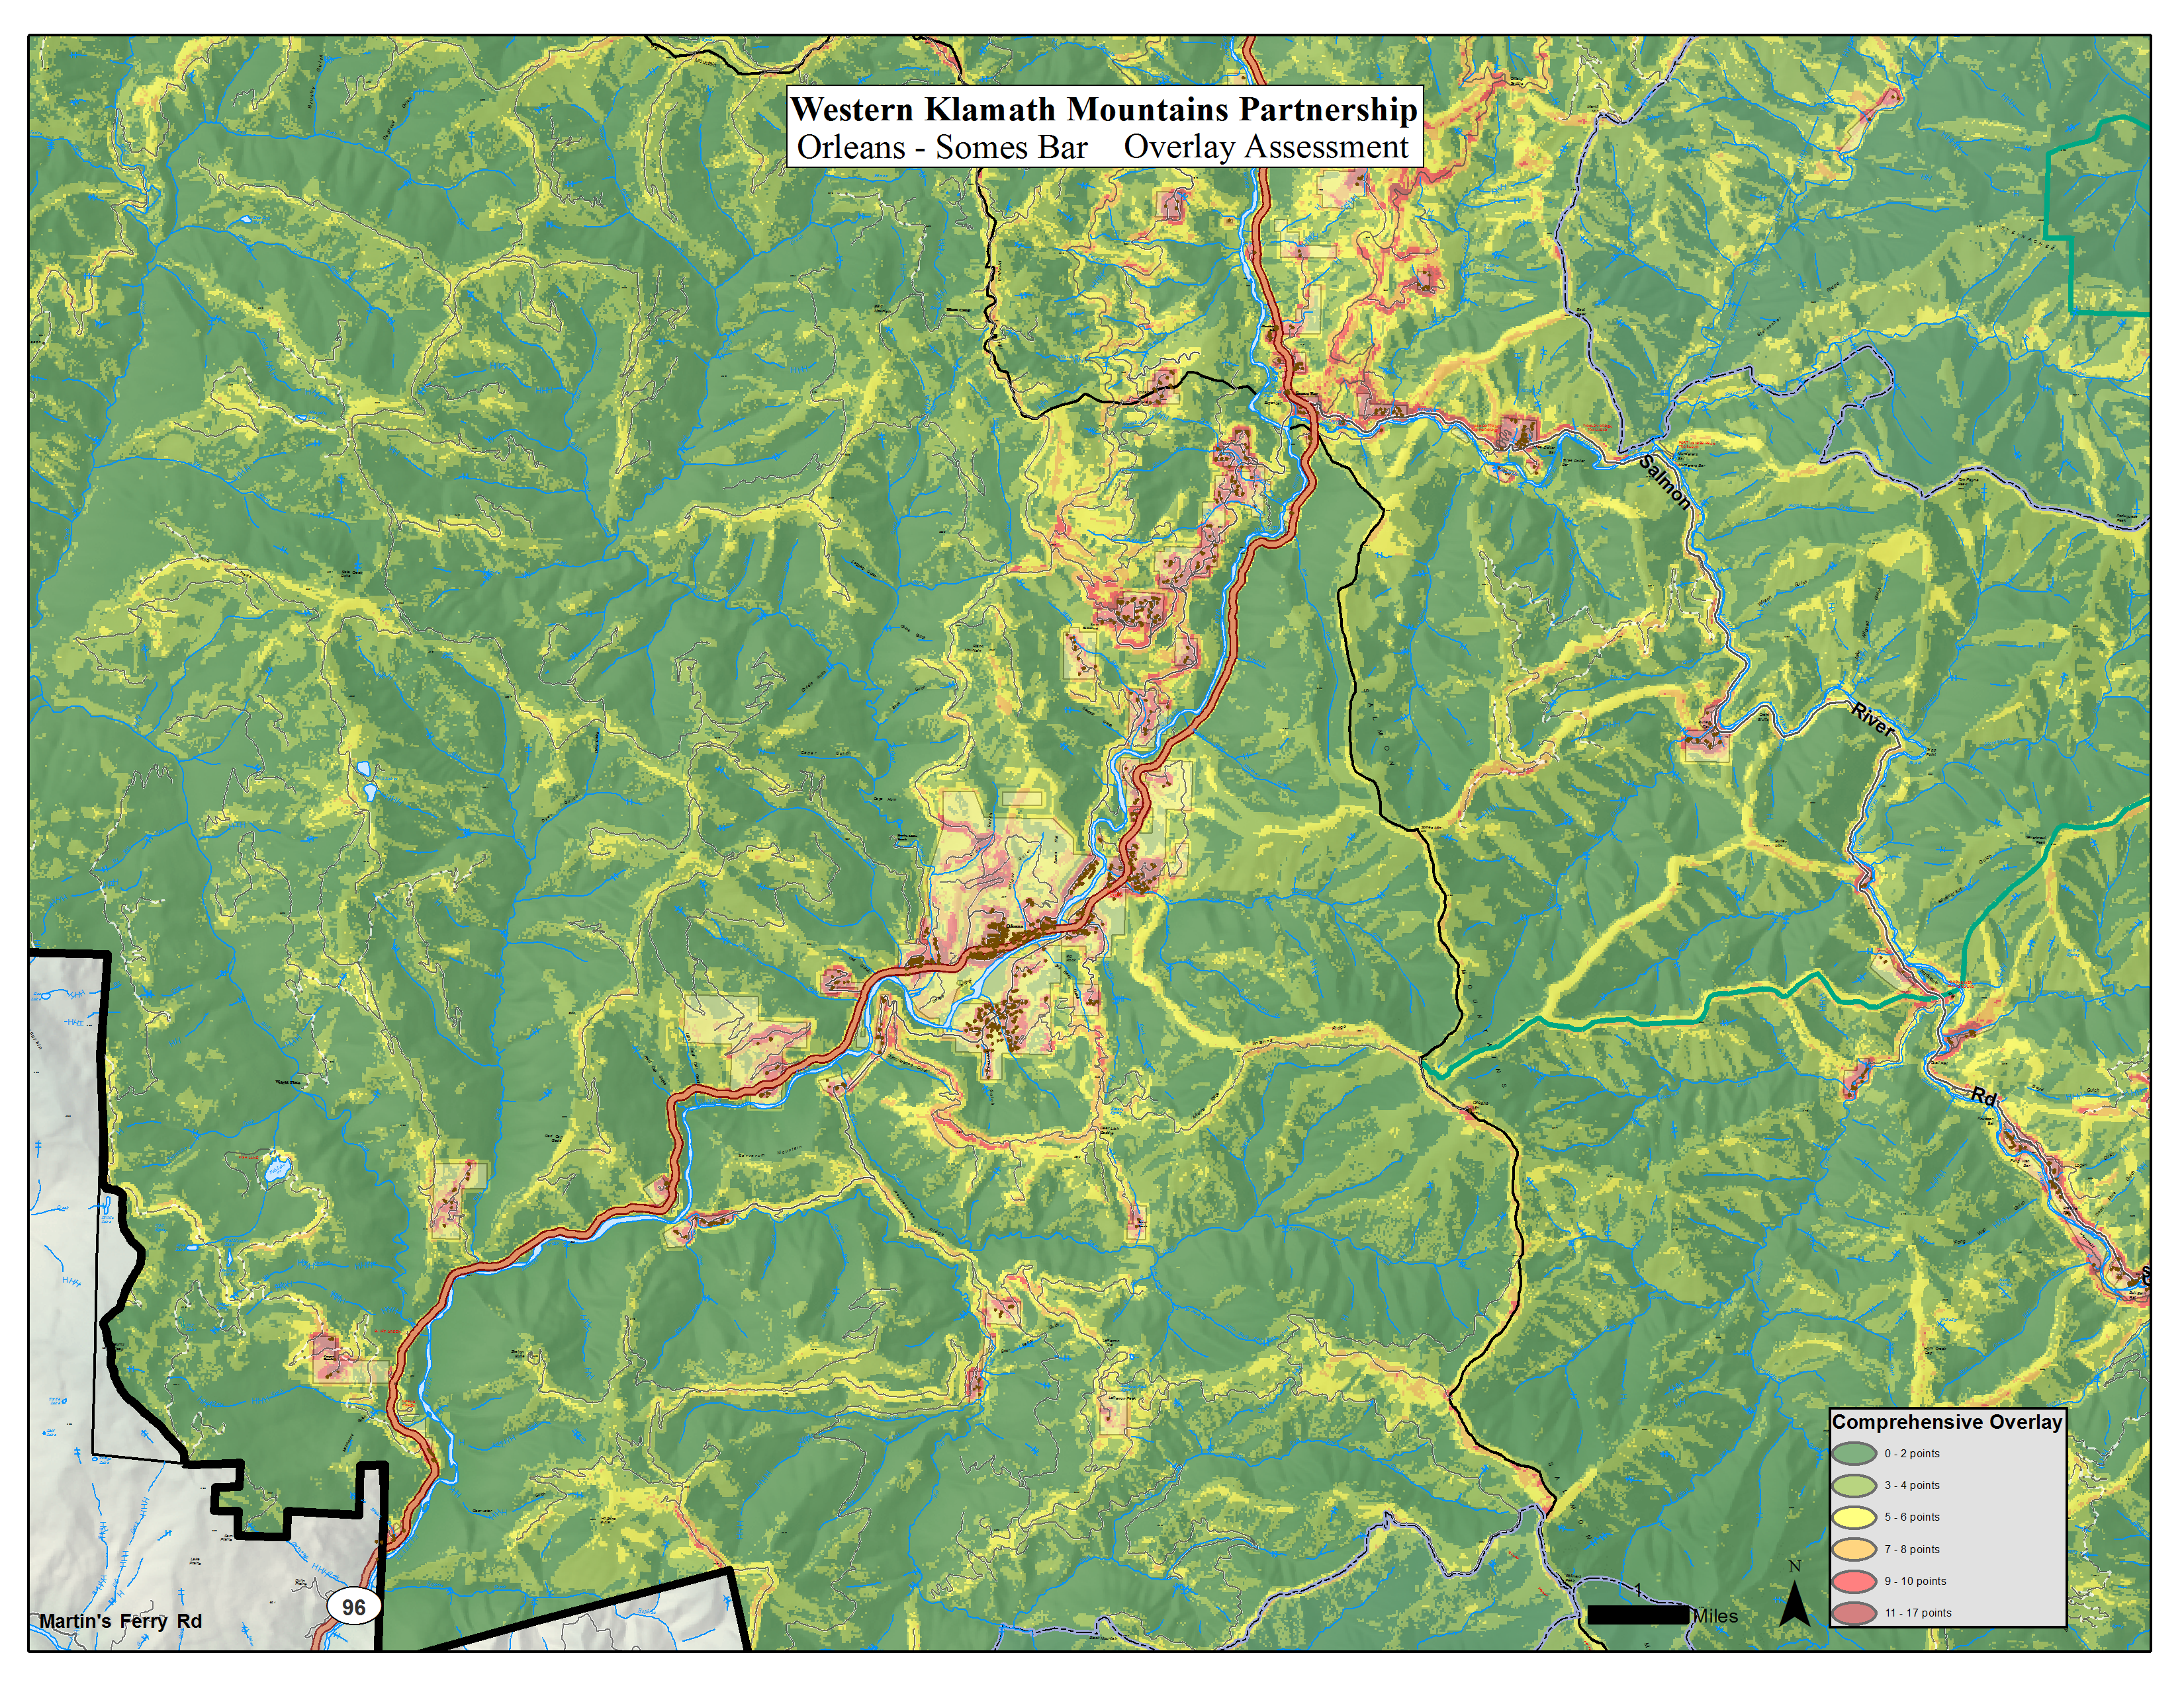
Western Klamath Restoration Partnership
Community Wildfire Protection Plan Layers
  Structures Layers
  Public/Private Property Boundary Layers
  Critical Access/Egress Routes
  Complete Road System (Public and Private)
  Manual Fuels Treatments (Public and Private)
  Upper 1/3rd Slopes
  Existing Firelines
  Insolation (Solar Heating) - South/Southwest Slopes
Karuk Eco Cultural Resource Mgmt. Plan Layers
  Historic Trail System Layer
  Klamath Mixed Evergreen (Tan Oak range)
  Klamath Siskiyou Lower Montane Serpentine Woodland
  Black Oak BpS
  White Oak Bps
  Spotted Owl Nest Sites Buffer
  Elk Winter Range Restoration Potential Layer
US Forest Service Silvicultural Layers
  Managed Stands Layer
  Mid Mature Dense Stands Layer
  Crown Fire Potential (97th percentile) or Flame length (0-4’, 4-8’, 8+)
Notes:
The Western Klamath Restoration Partnership is a small group of committed tribal and non tribal entities that is working revitalize a continual human/fire relationship. This overlay assessment is comprised of an initial set of geospatial layers that is inclusive of multi-organizational planning efforts.
Though this representation is not a complete list of layers, or final mapping product, it outlines a starting point for identifying priorities, delineating firesheds, re-vitalizing the human-fire relationship, and restoring fire to the land. This approach enables us to initiate a truly intergenerational adaptive management process into our lives, landscapes, and the actions of future generations in a manner applicable to all communities of place.

Slide 4
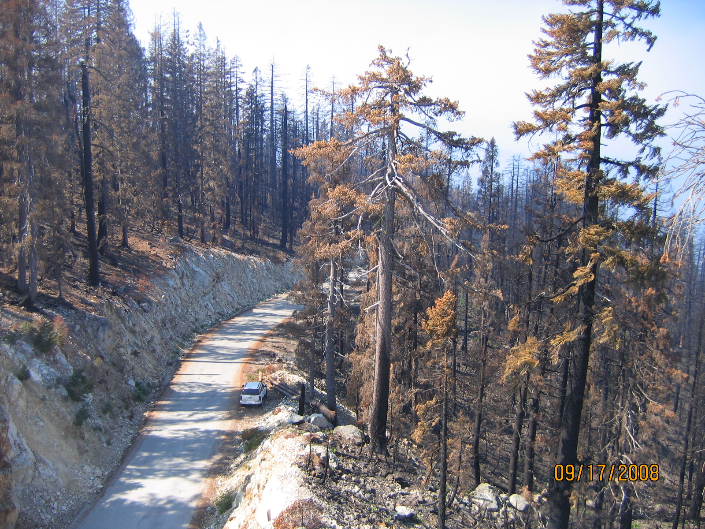
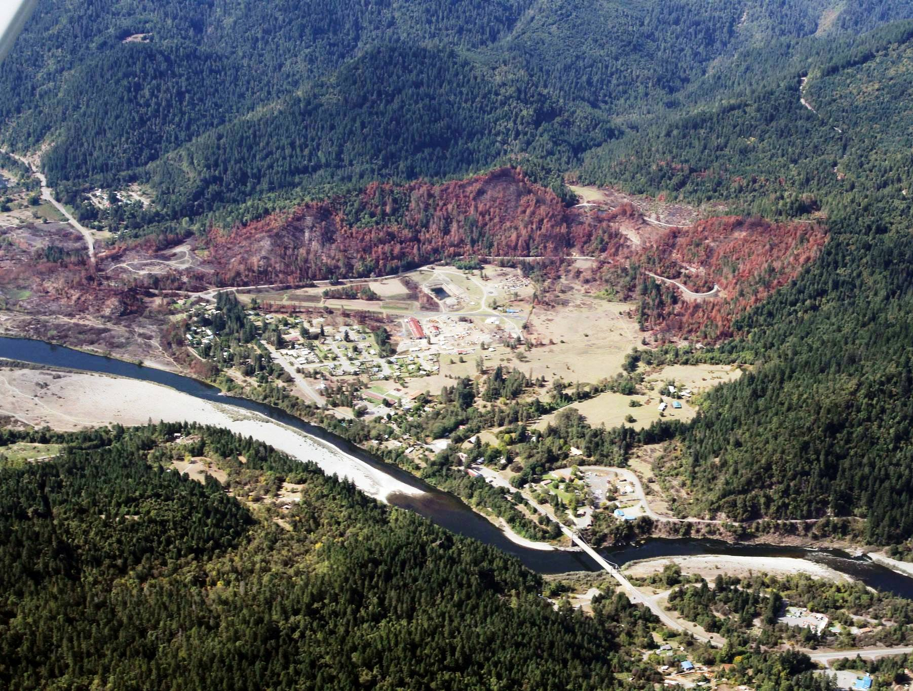
Rock Creek Butte Burnout
2008 Siskiyou Complex
Orleans Fire July 2013
How Do We Eliminate Fire as a Destructive Force?
Photo by Thomas Dunklin
Photo by Max Creasy
Notes:
Though National direction calls for all wildland fire management decisions to be based on risk, we need to carry out a process that enables long term benefits to outweigh short term risks. Fire is an increasingly destructive force because humans have been working against it for so long. Tens of thousands of acres of stand replacing fire are now occurring when the natural range of variability in an indigenous fire regime it would be confined to single and double digit acreage.
How do we eliminate Fire as a destructive force?

Slide 5
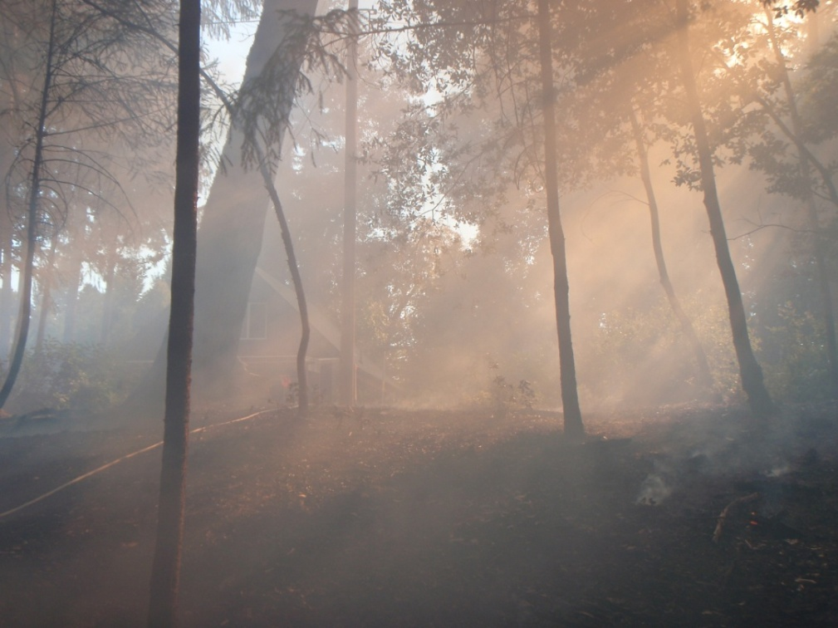
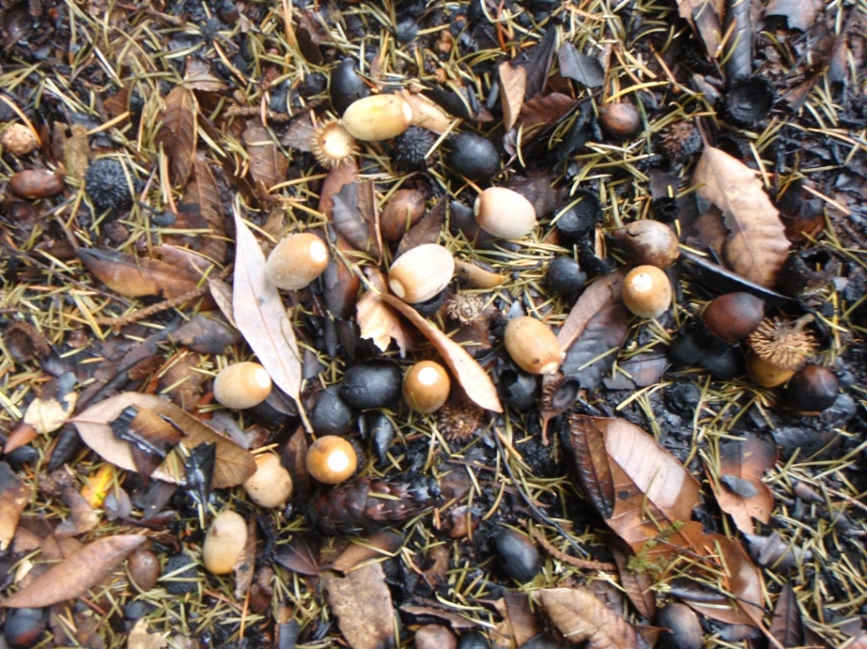
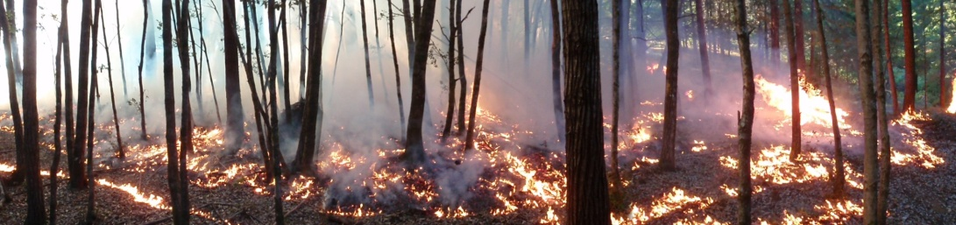
We Manage Fire to Achieve Socially Beneficial Results
Restoration practices that balance biophysical processes, protect lives and property, and sustain resources of and for fire adapted communities.
Maintenance and enhancement treatments scaled to ensure longevity of effectiveness.
Respond to disturbance in a manner consistent with long term strategies.
Adapt to change through time and space.
Re-establish cumulative bodies of knowledge, practice, and belief.
Frank Lake Photos
Notes:
What potential benefits can be found in this slide?
Risk to home in background is diminished.
Risk of stand replacement fire in Tan Oak Stand is mitigated
Heat and smoke may have fumigated canopy disease and pathogens
Evapotranspiration rates temporarily reduced
Mycelium chain moisture uptake and distribution cycle temporarily modified
Insect reproduction levels in from fresh acorn drop are reduced
Incomplete combustion of surface fuels contributes to below ground carbon storage
Duff reduced for additional food and fiber resources to proliferate; and
Worm free acorns readily available for animals and humans to share
There are an indefinite amount of additional benefits that can be derived from this treatment. Institutionalization of workforce development and adaptive management, research, and monitoring will be vital components of addressing adaptability through changing climate.

Slide 6
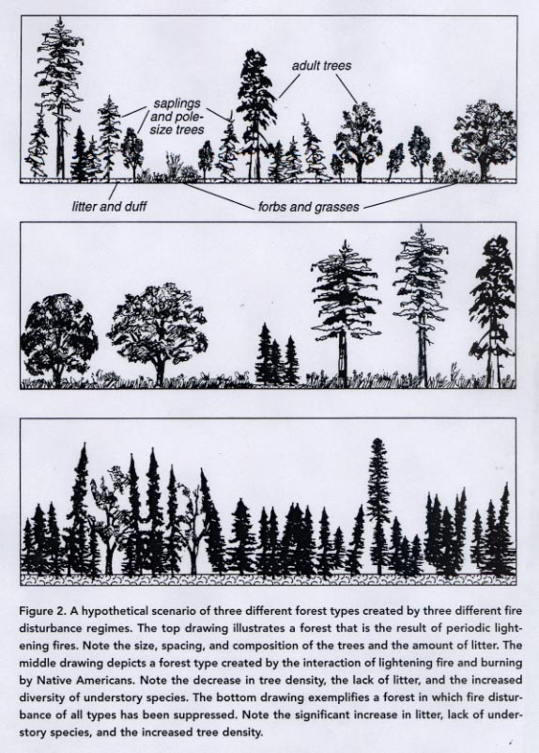
Affects of Indigenous land management practices on forest diversity
Forest types and fire regime
Composition, structure, function and productivity
Interplay of lightning fires and indigenous burning
  Top-lightning
  Middle-lightning/Indian burning
  Bottom-fire suppression
Anderson and Barbour 2002: Calif. Forests
Notes:
Recent studies begin to show differences in how forests respond to human interaction with ecological processes such as fire. Of course at the landscape level, stand dynamics would be much more complex than represented in this slide, but in general, the center example would be much more productive than the top. There is a high likelihood that the bottom example will trend toward brush in a continued fire exclusion model (especially in areas where increased frequency and severity overwhelm available suppression resources due to resource drawdown and other factors). So in short, the indigenous human/fire relationship maximizes benefits while diminishing risk, while the suppression model exacerbates risk and defers it to future generations, firefighters, ecosystems, cultural identity, and the public, not to mention deficit spending.

Slide 7
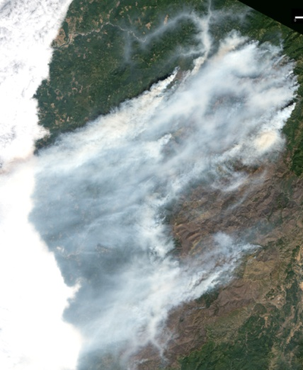
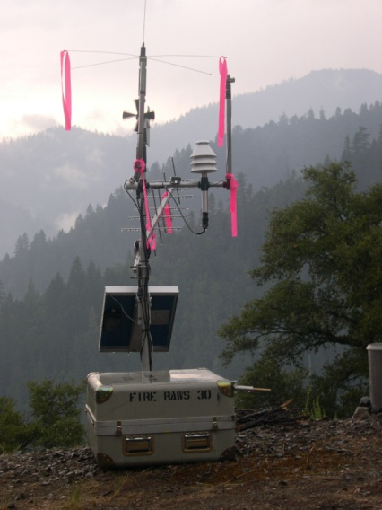
Linking TEK, salmon life history migration, Air & Water Quality, and wildfire research
How Do Fire Regimes relate to Fish & River Health?
Smoke
Reduced Evapo.Trans
Graph: Karuk Tribe,
Top Photo: MODIS, Collaborative ideas and data sharing
Notes:
Expanding research to address non-typical potential benefits vs risks is currently under way. Does fire affect fish? How can this be? This slide represents emerging collaborative ideas and data sharing around some unique benefits and risks of smoke. The theory is that in periods of peak temperature, smoke shading and canopy fumigation can reduce water temperature and increase in-stream flows. TEK has supported this assumption for an indefinite period, and preliminary data is showing consistency in this thought process. Air and water measurements are showing temperatures dropping to at or below the stressful levels for salmoid species following onset of inversion. Flows are also showing a marked rise, but we need to factor in more considerations like sub-basin thunderstorm rainfall, upstream dam releases, and how they correlate fire ignition events in order to compile a statistical analysis.

Slide 8
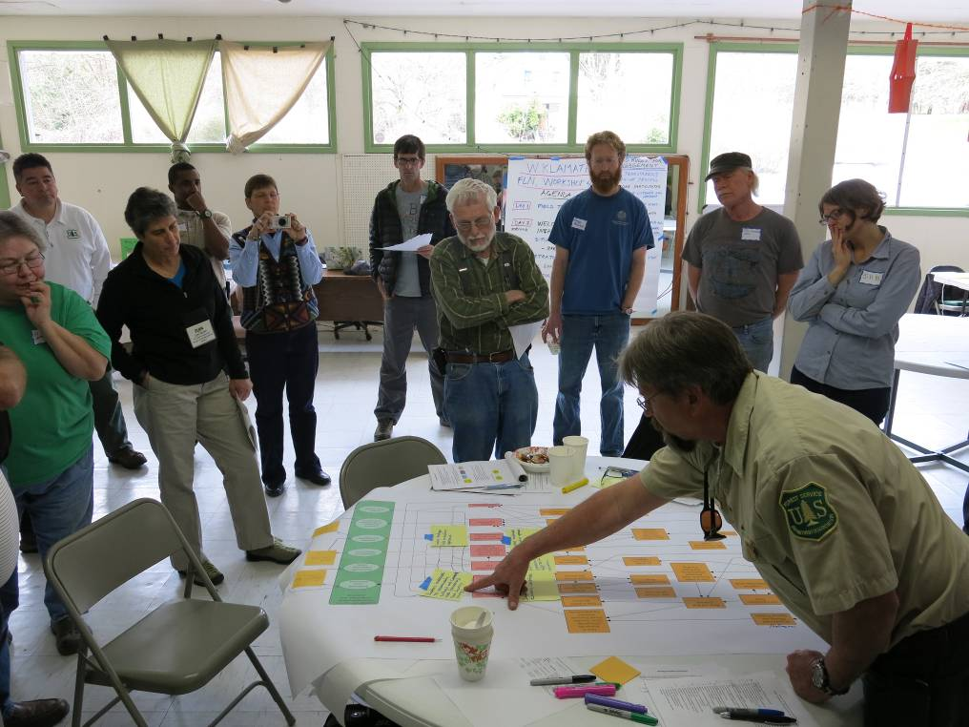
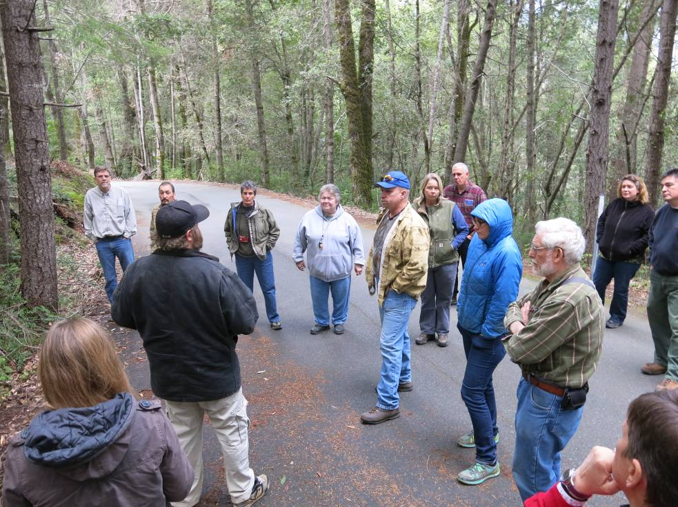
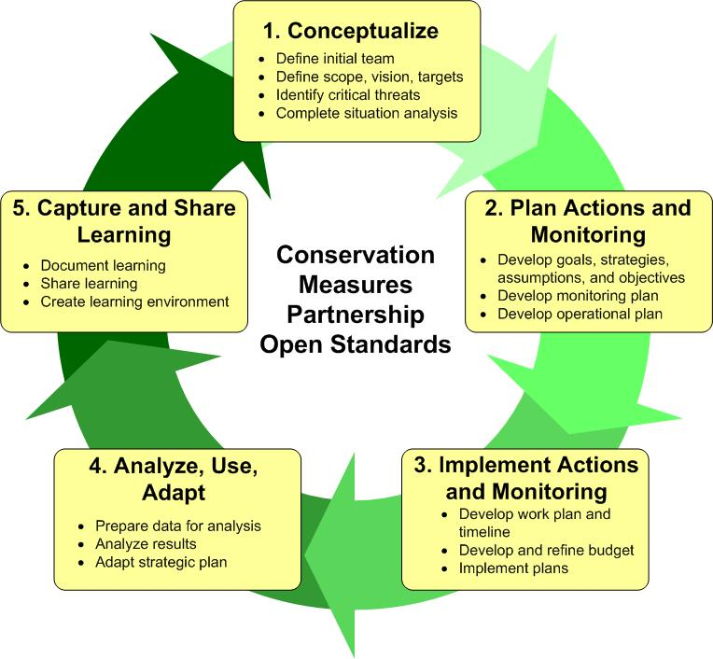
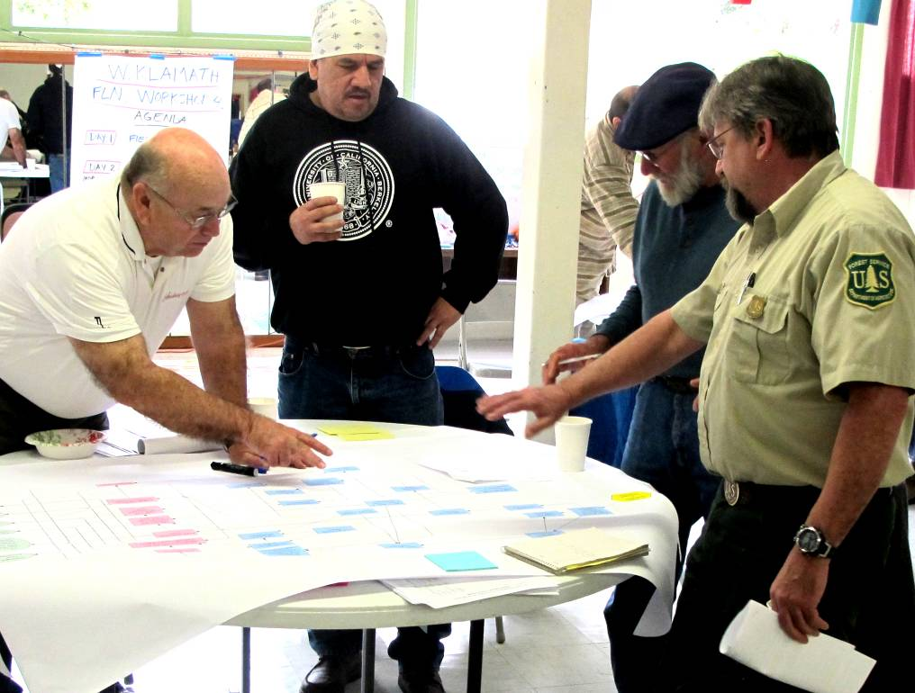
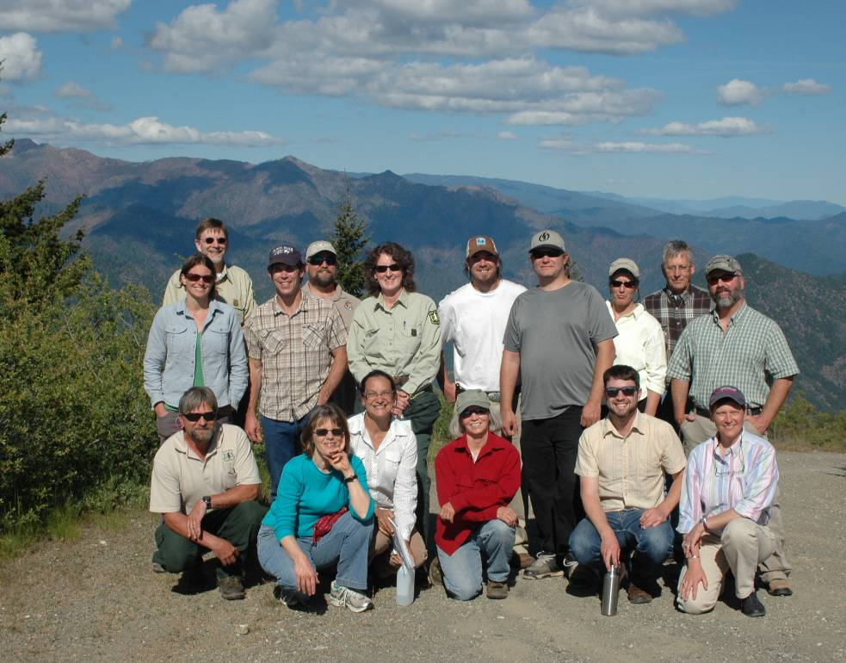
Notes:
Which leads us to the open standards process for conservation planning. With TEK in the drivers seat; the support of greater tribal and non-tribal communities; and research standing alongside our workforce, we can collaboratively conceptualize and plan; cooperatively implement and monitor; consistently analyze, use, and adapt; collectively capture, share, and learn; and continue an intergenerational process that lives, grows, and re-vitalizes a place based cumulative body of knowledge, practice and belief.
As all you fire folks know, situational awareness is critical.

Slide 9
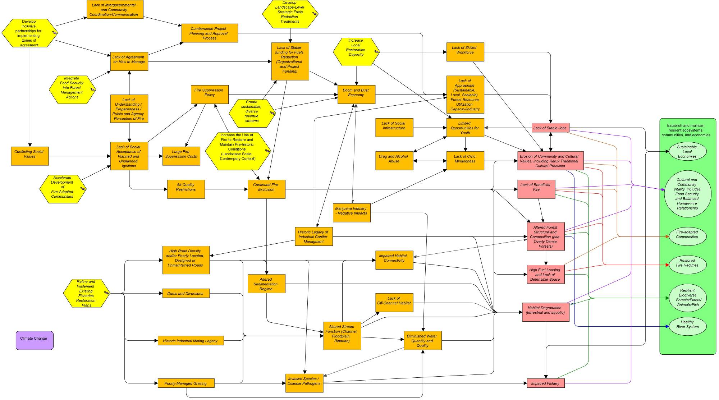
Situation Analysis Diagram – Open Standards Process for Conservation Planning
Notes:
And here is a recent draft of our current situation. We have things like climate change as a stressor; we have things like lack of intergovernmental coordination and community collaboration and communication forming a pathway to erosion of community and cultural values; we have conflicting social values leading to lack of beneficial fire; and lack of agreement how to manage leading to high fuel loading and lack of defensible space.
Of course there is more to it than what is shown here, but we now have identified insertion points, and strategies in development that should turn threats to our Values into results oriented actions and activities intended to achieve benefits that improve the viability of our Targets.

Slide 10

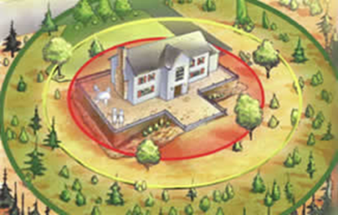
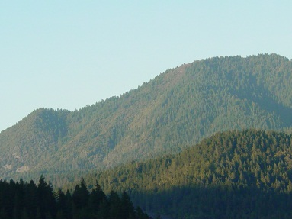
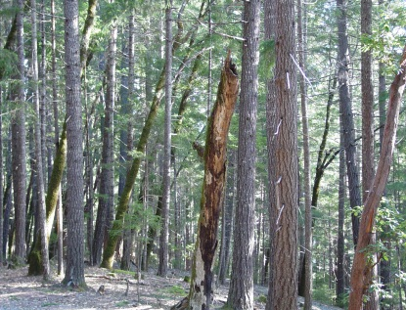
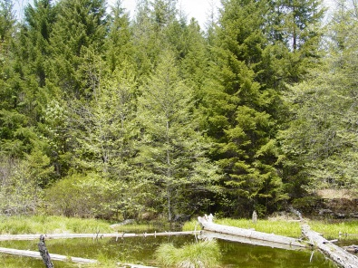
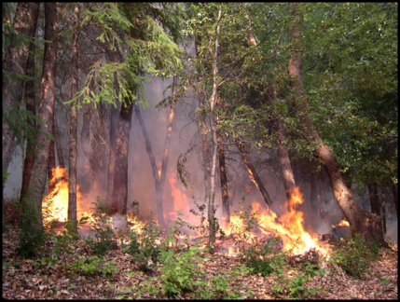
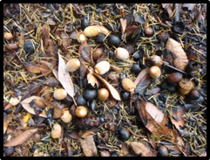
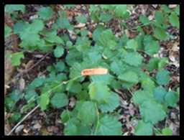
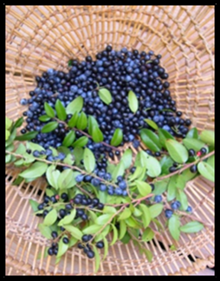
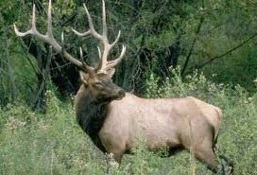
Notes:
We have defensible, culturally relevant, and expandable prioritization metrics that can be modified through time while maintaining consistency in our strategic direction.

Slide 11
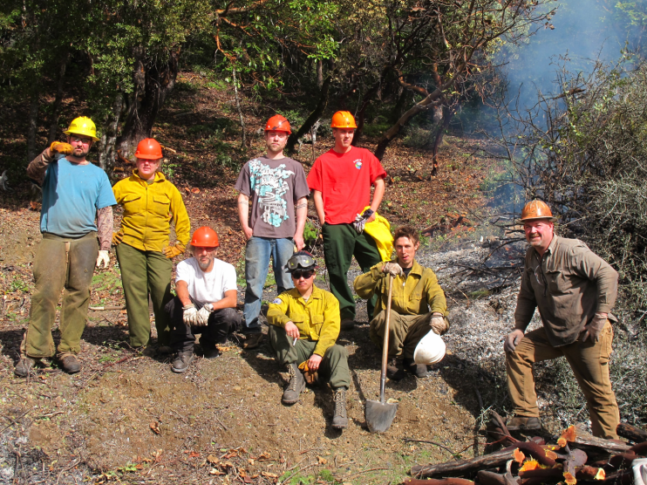
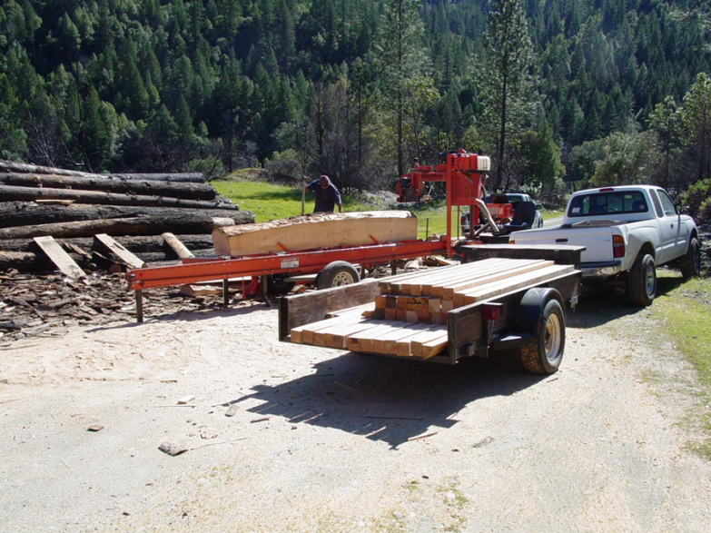
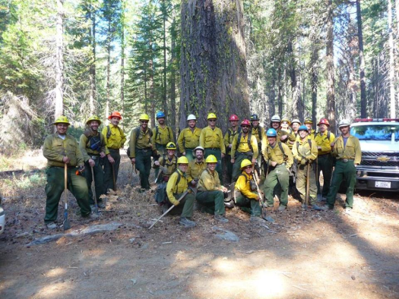
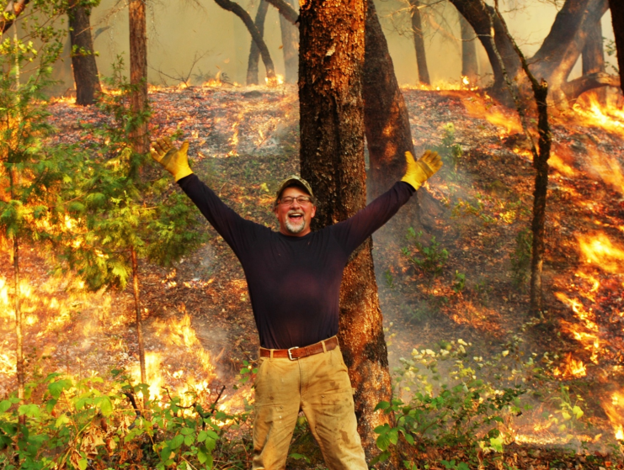
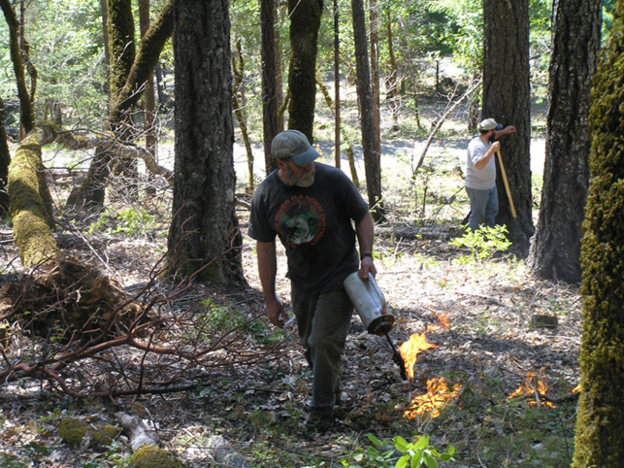
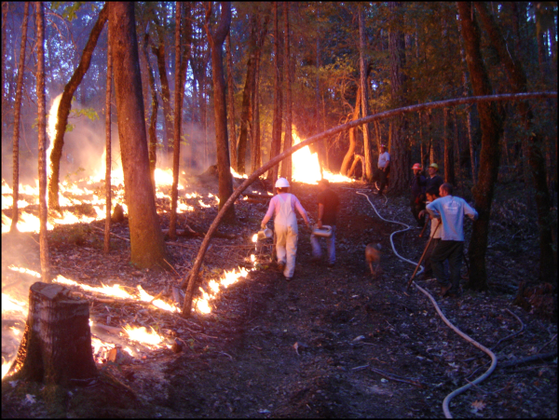
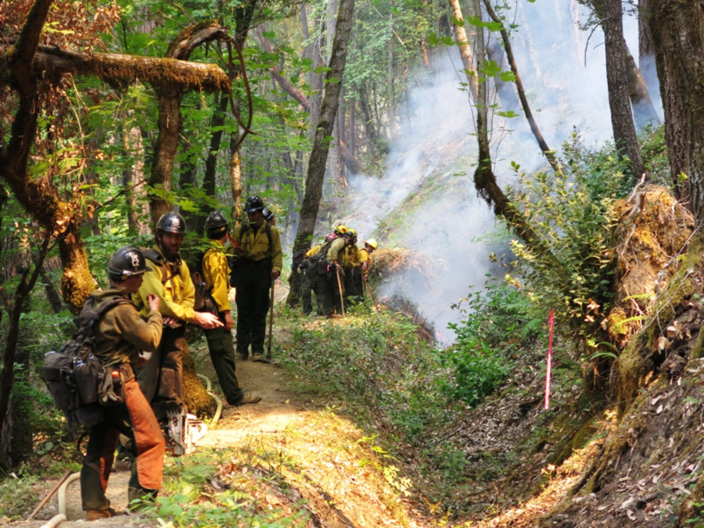
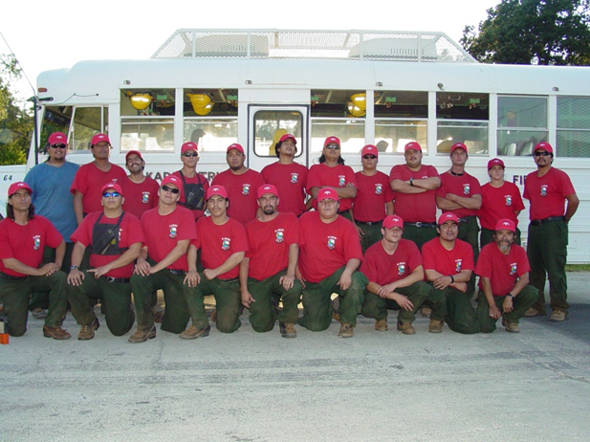
Notes:
We have a multi-organizational workforce ready for concentrated on the job learning and capacity expansion to increase the scope and scale of treatment and maintenance.

Slide 12
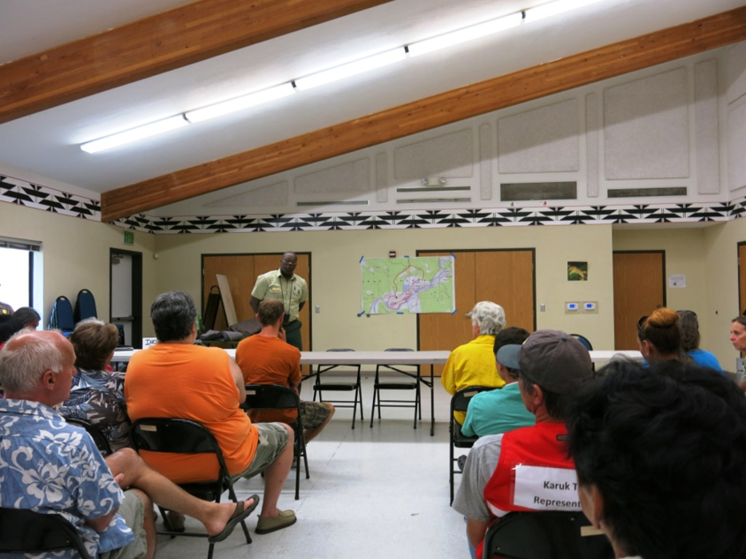
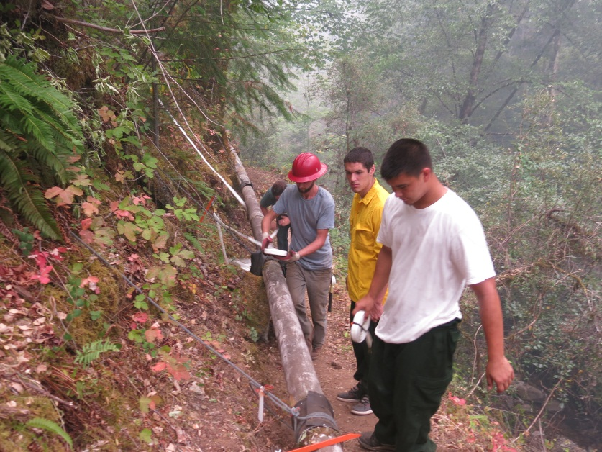
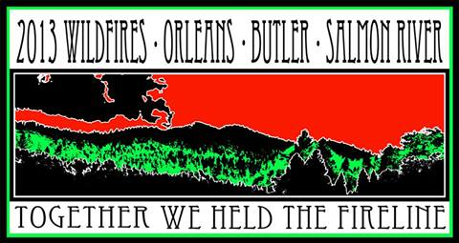
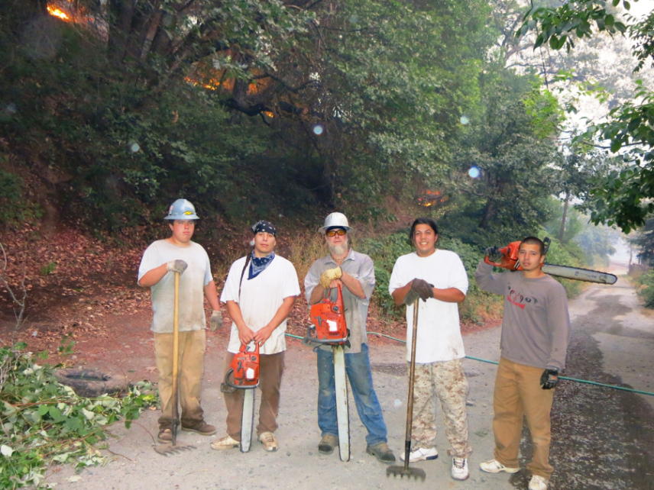
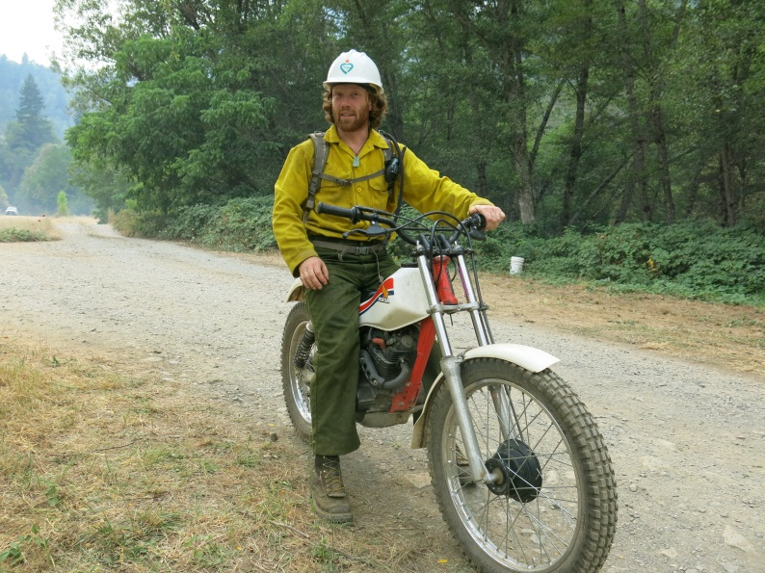
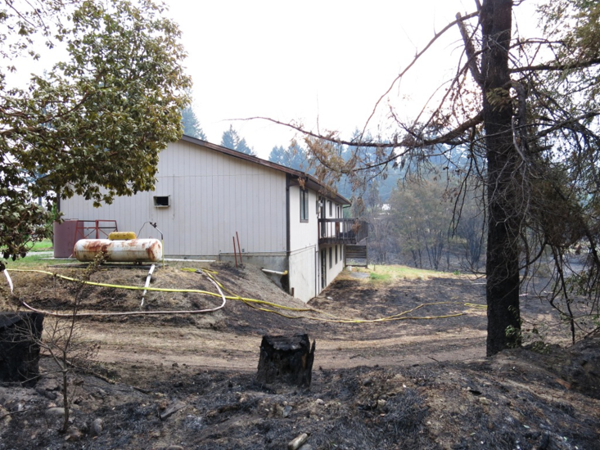
Notes:
We have communities willing to respond accordingly.

Slide 13
Intergovernmental coordination
Non-governmental collaboration
Mid Klamath Watershed Council
Salmon River Restoration Council
Happy Camp Coordinating Council
Karuk Community Development Corporation
Karuk/UC Berkeley Collaborative
Orleans Volunteer Fire Department
Salmon River Volunteer Fire and Rescue
Orleans/Somes Bar Fire Safe Council
Salmon River Fire Safe Council
Happy Camp Fire Safe Council
The Nature Conservancy
Fire Learning Network
Hayfork Watershed Research and Training Center
National Forest Foundation
National Fish and Wildlife Foundation
Rocky Mountain Elk Foundation
Northern California Prescribed Fire Council
California Fire Science Consortium
Karuk Tribe
US Forest Service
US Fish and Wildlife Service
Environmental Protection Agency
Bureau of Indian affairs
NOAA Fisheries
National Park Service
Bureau of Land Management
Departments of the California Natural Resources Agency
Natural Resources Conservation Service
Bureau of Reclamation
Yurok Tribe
Hoopa Tribe
Pacific Southwest Research Station
Inter-Tribal Timber Council
California Indian Forest and Fire Management Council
National Congress of American Indians
Notes:
And we have plenty of current and pending partners that can support a plethora of roles and responsibilities that will be needed to do the job.
We now need to expand upon, coordinate, and institutionalize these capacities…

Slide 14
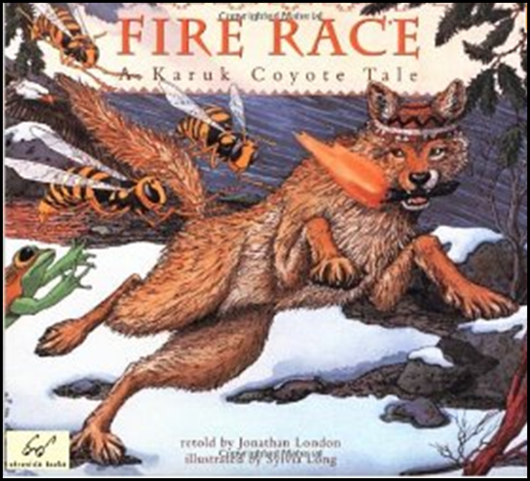
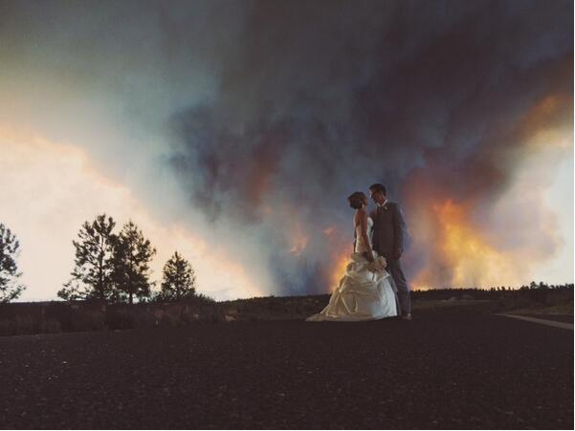
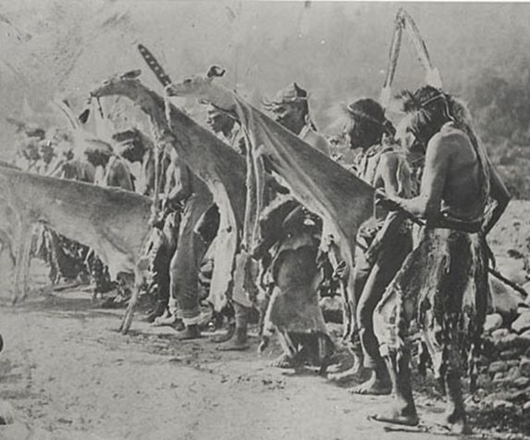
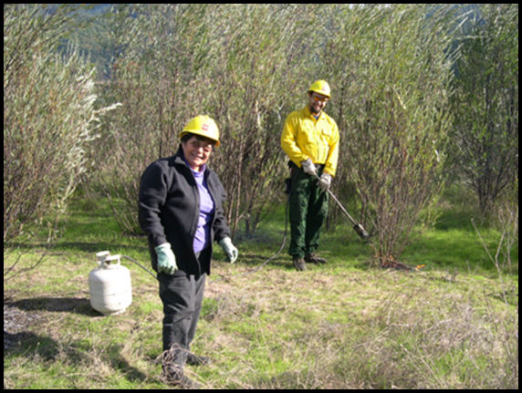
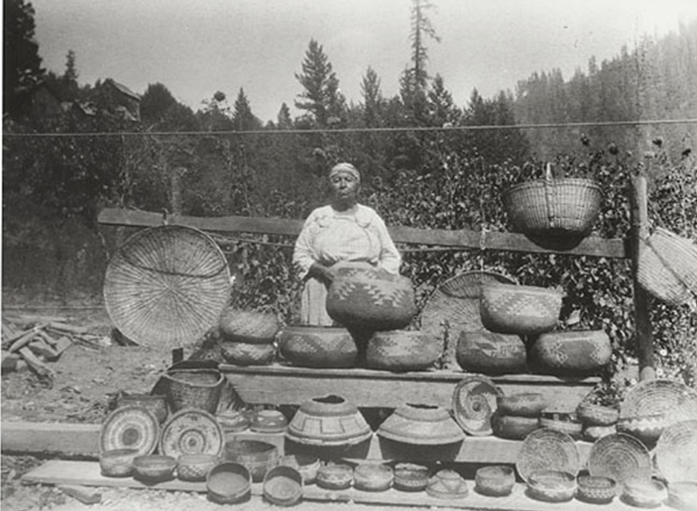
Notes:
So together we can re-vitalize our human/fire relationships and return good fire to the land

Slide 15
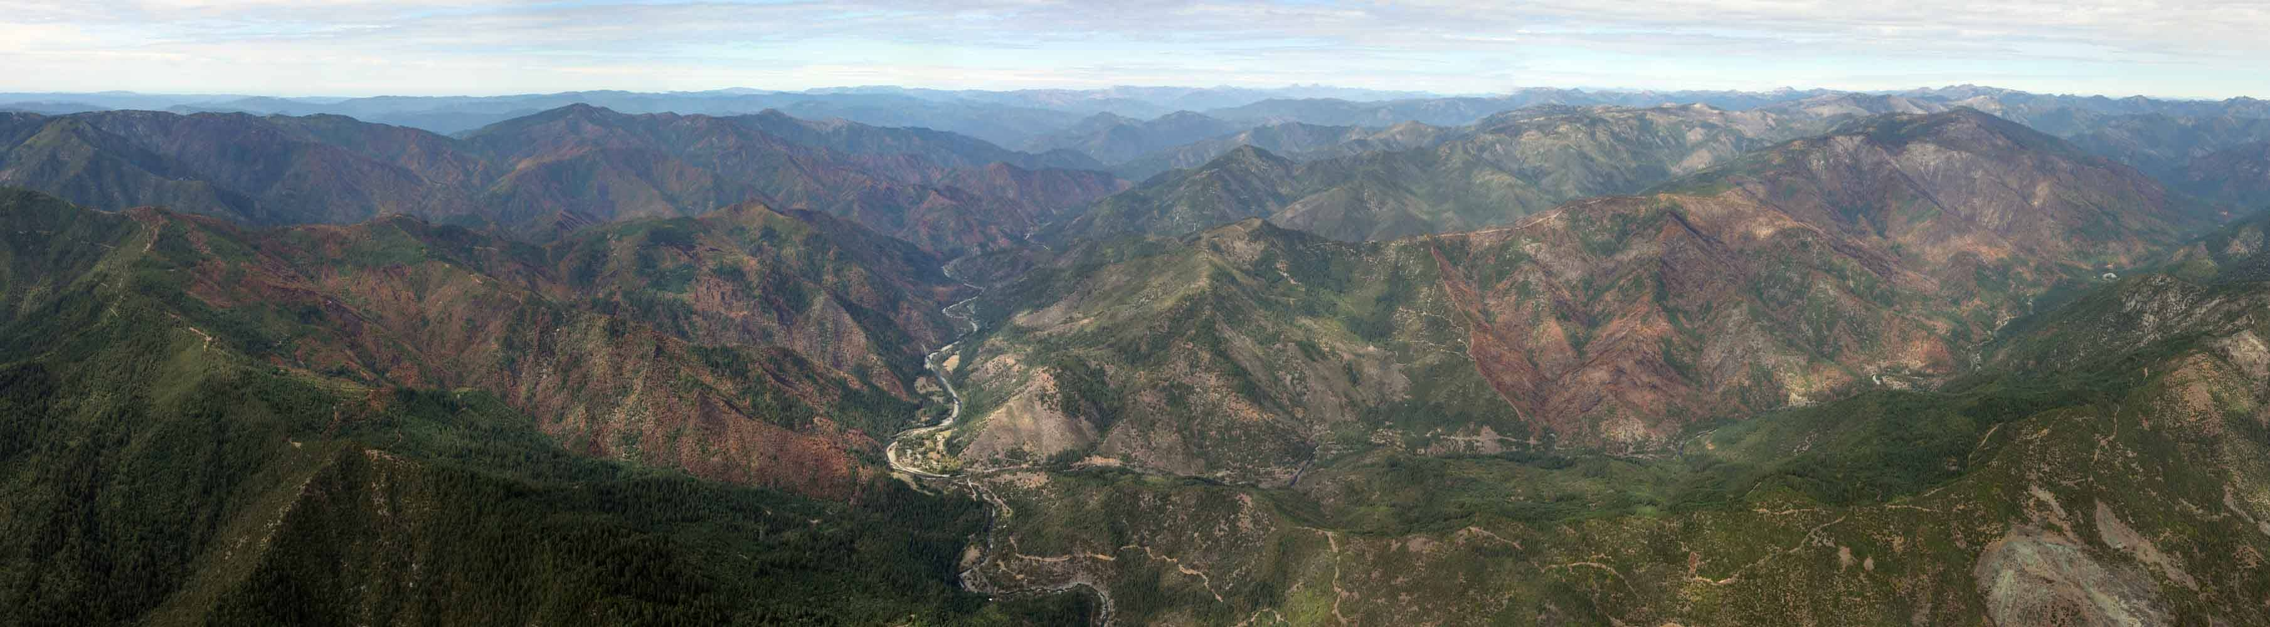
Questions?
Photo: Thomas Dunklin

